Slide 1
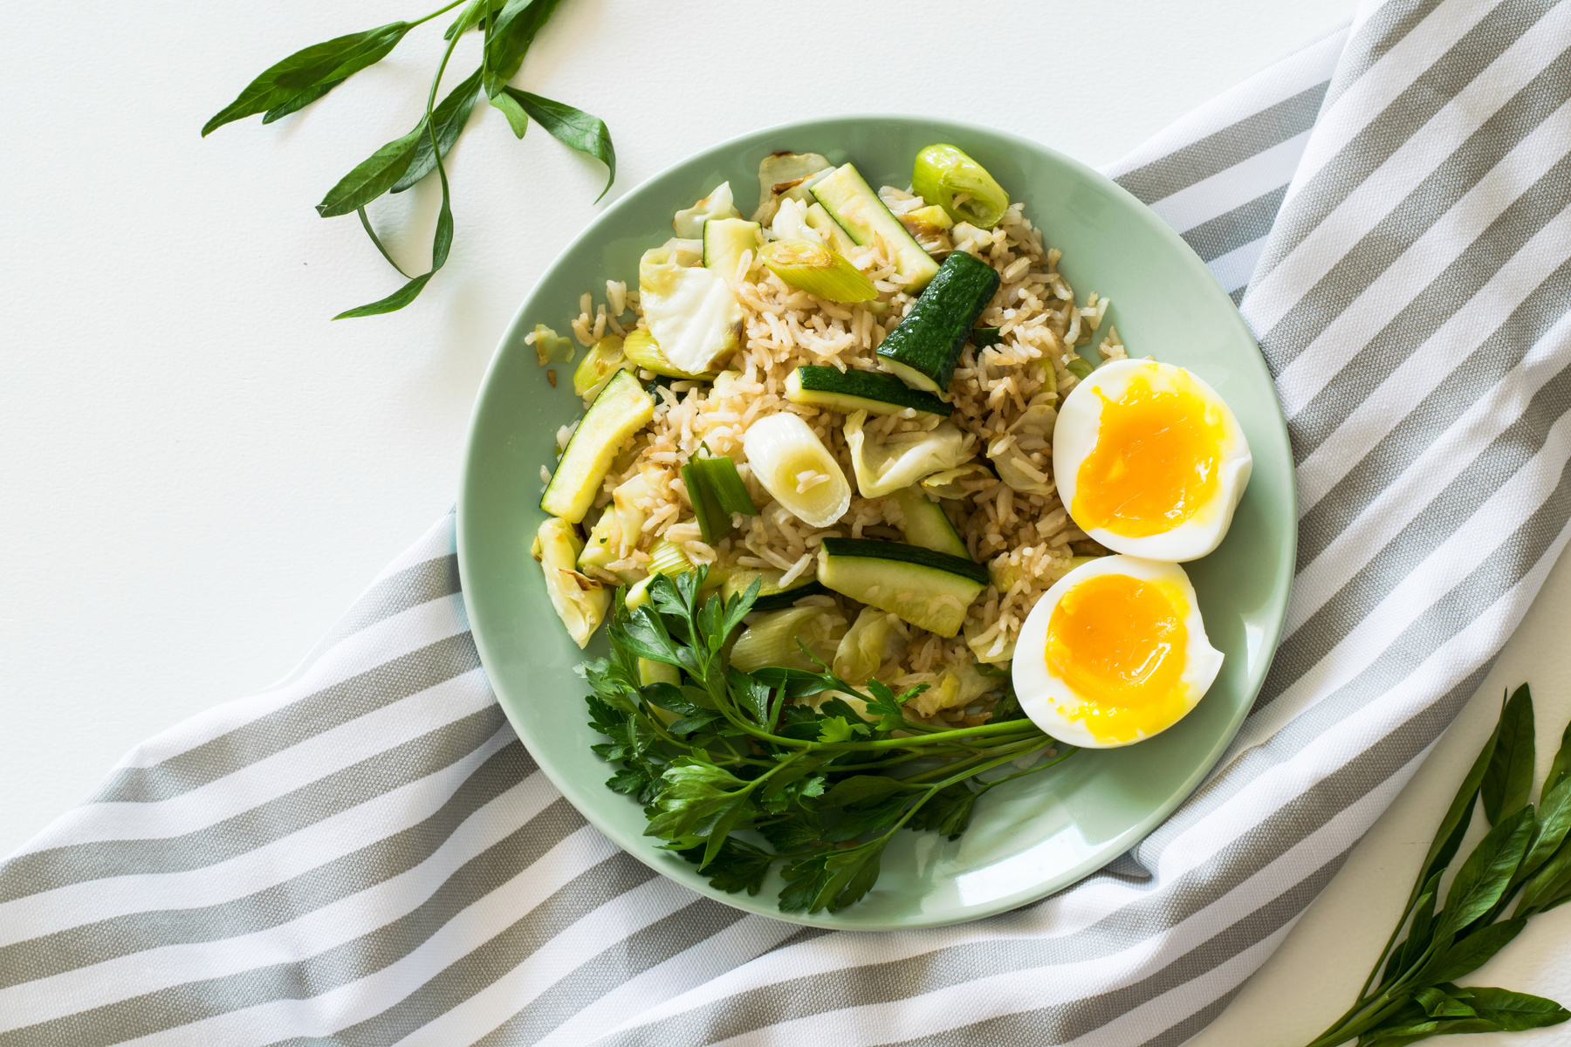
REVOLUTIONIZE YOUR DINING EXPERIENCE:
PRE-ORDER FOOD AND SAVE TIME
A Comprehensive Platform for Pre-Ordering Meals from Various Restaurants

Slide 2
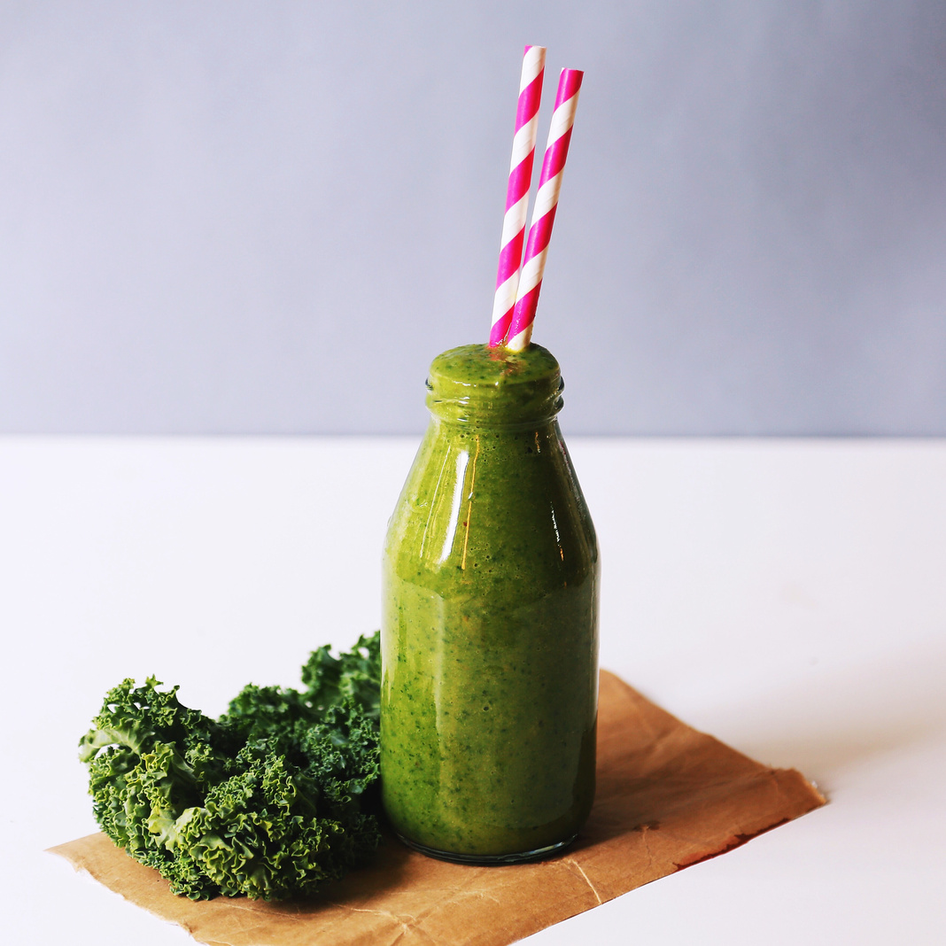
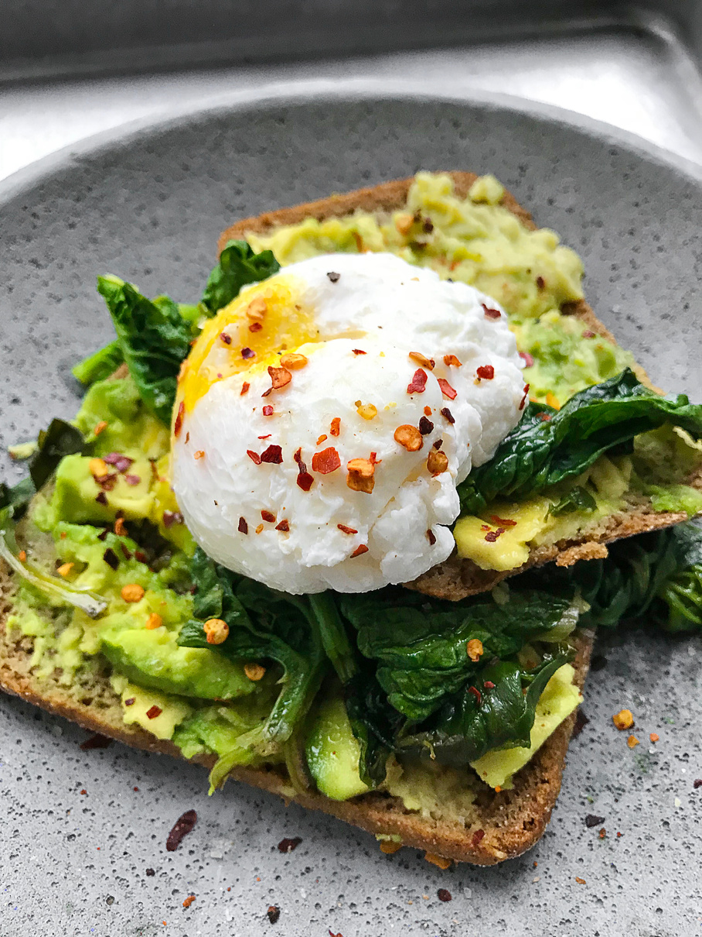
INTRODUCTION
Brief introduction to the concept of pre-ordering food.
Overview of the problem: long wait times at restaurants.
Solution: Our website allows users to pre-order food and reduce waiting time.

Slide 3
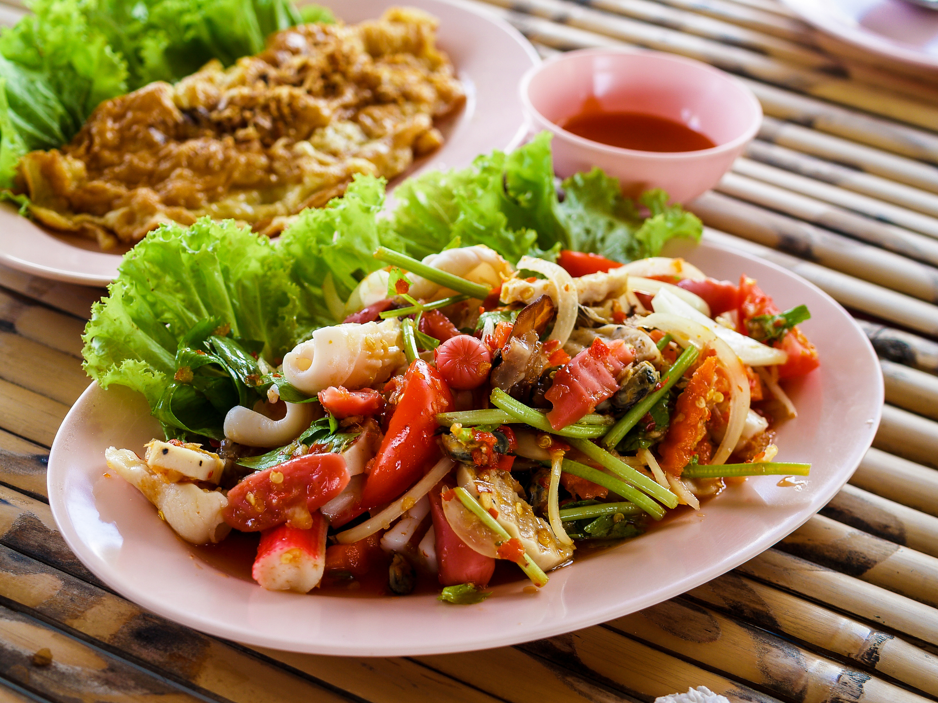
HOW IT WORKS
STEP-BY-STEP PROCESS FOR USERS:
->Browse participating restaurants.
->Select and customize their order.
->Pay 50% of the total bill online.
->Order 15-20 minutes before arriving at the restaurant.
->Emphasize the hot and fresh food upon arrival.

Slide 4
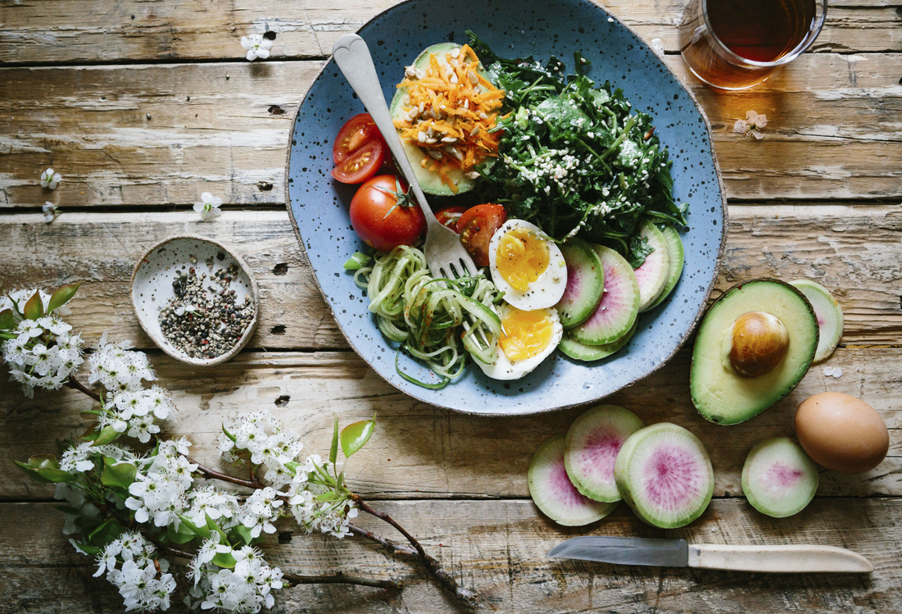
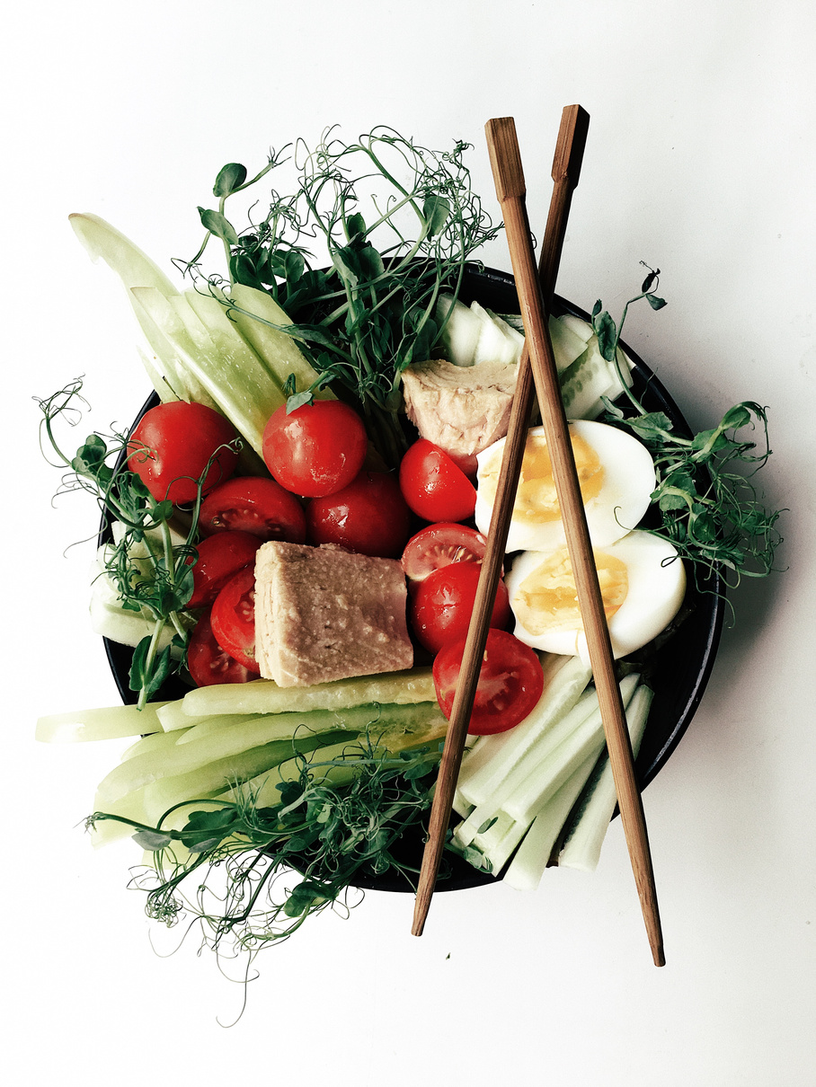
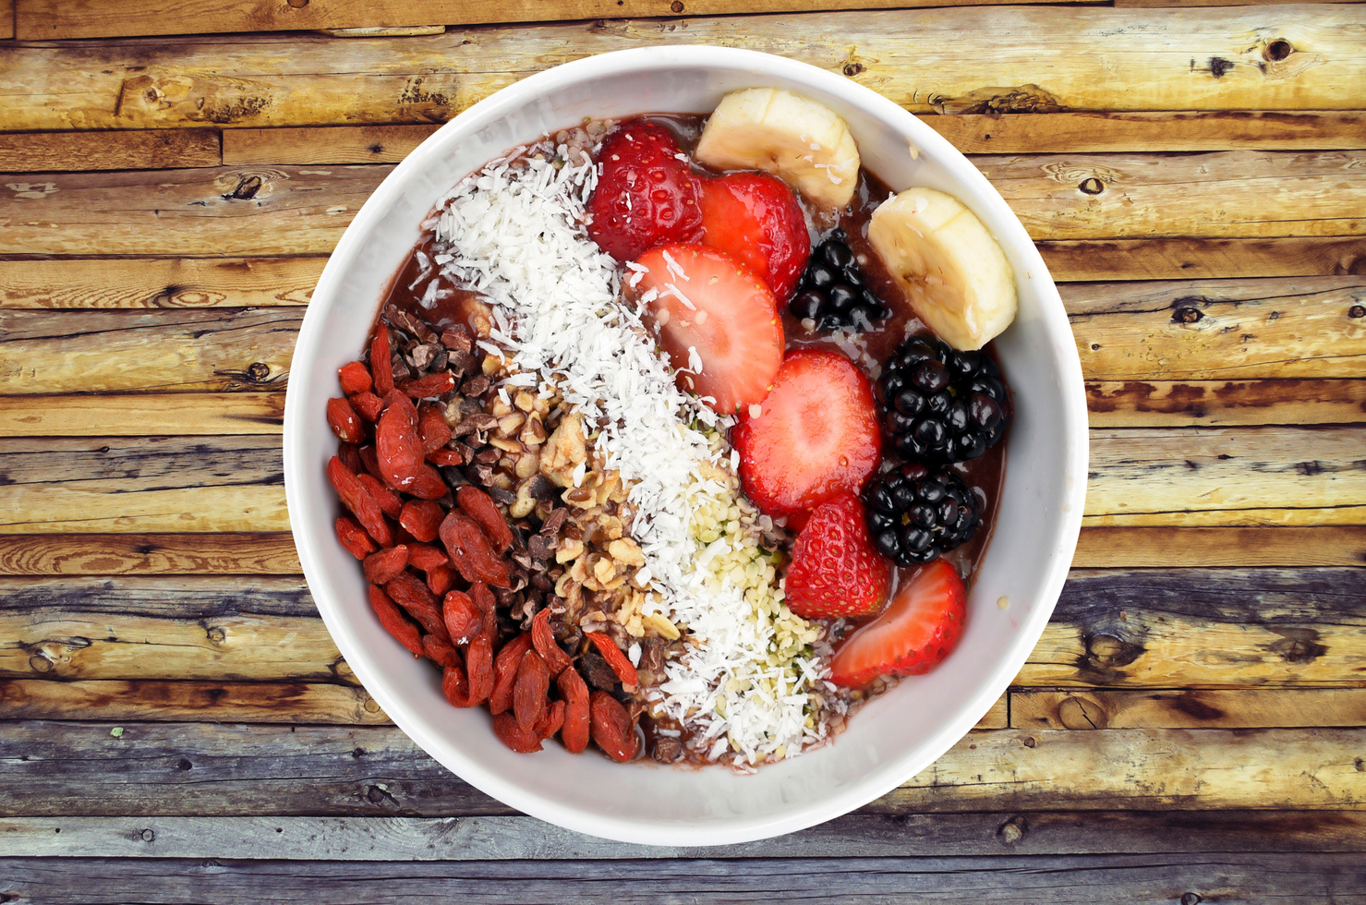
BENEFITS FOR USERS
Save time and avoid waiting.
Ensure hot and fresh food.
Easy and convenient ordering process.
Variety of restaurants on one platform.

Slide 5
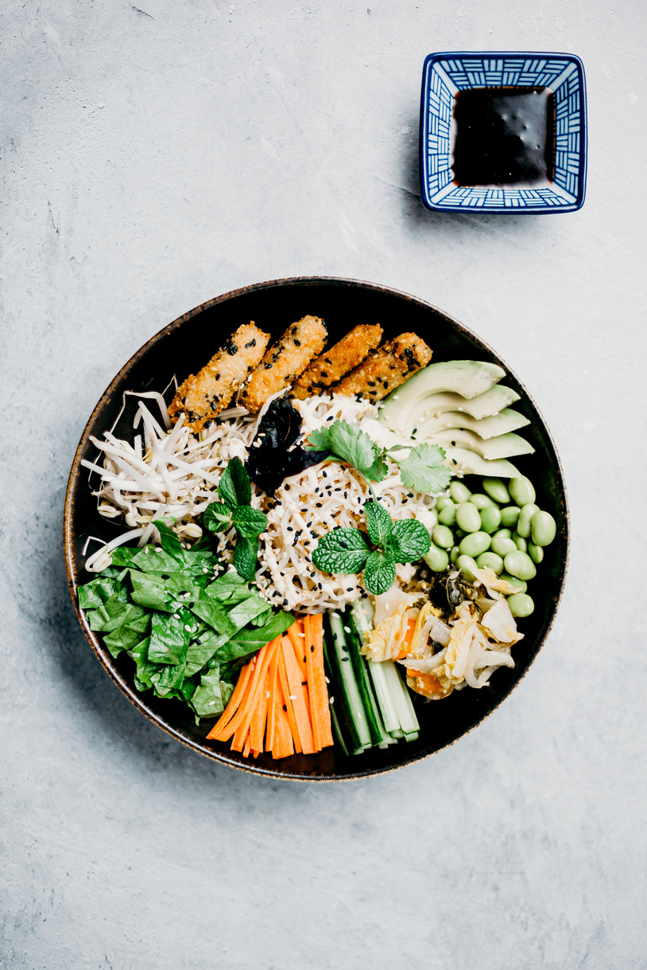
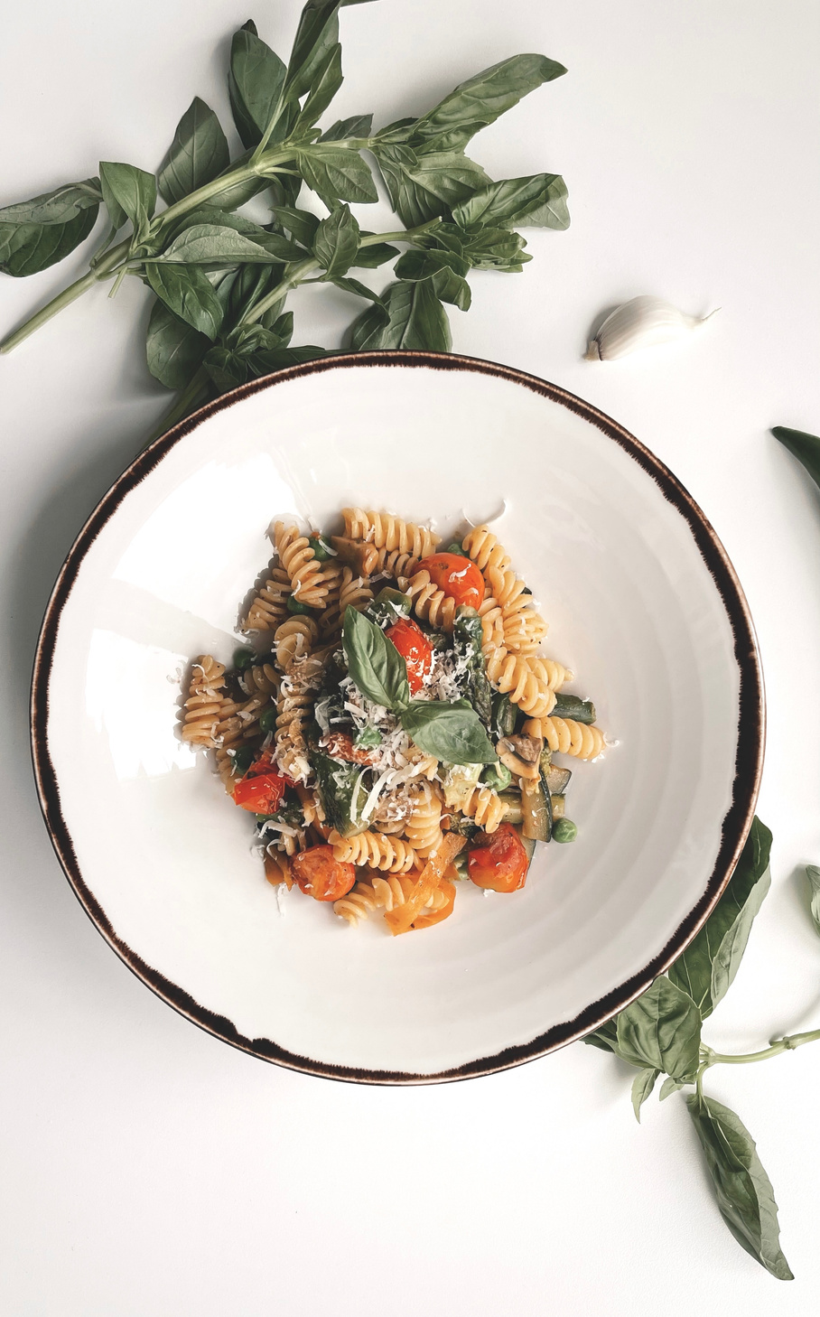
BENEFITS FOR RESTAURANTS
Increase in pre-orders and revenue.
Improved customer satisfaction.
Efficient kitchen management.
Reduced table turnover time.

Slide 6
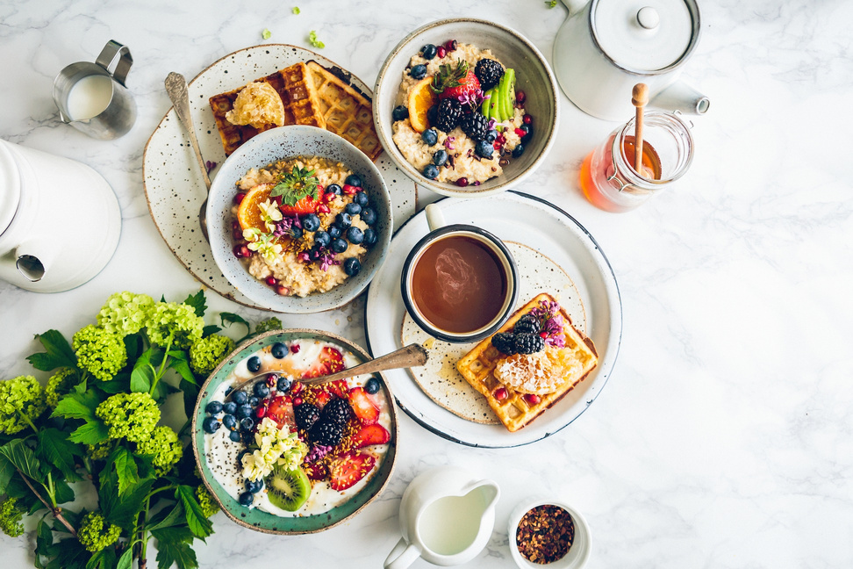
FEATURES OF THE PLATFORM
User-friendly interface.
Secure payment gateway.
Real-time order tracking.
Restaurant reviews and ratings.
Loyalty programs and discounts.

Slide 7
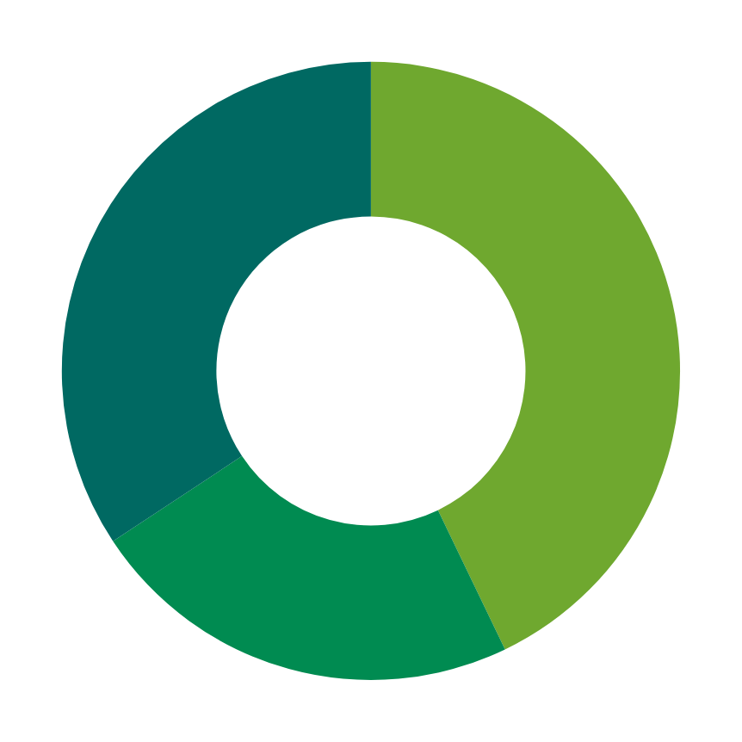
REVENUE MODEL
Commission on each order.
Advertisement space for restaurants.

Slide 8
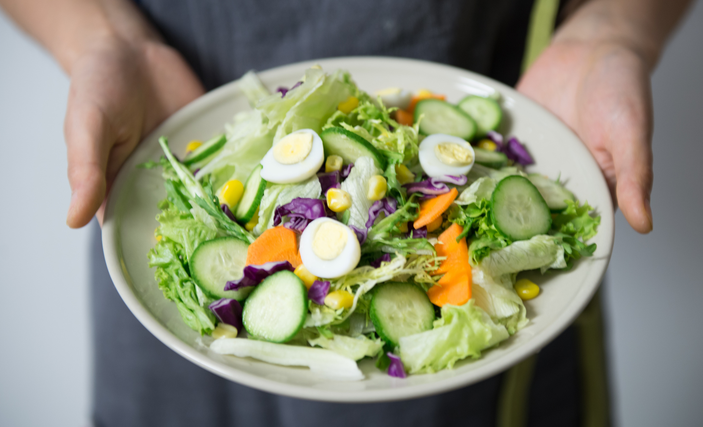
IMPLEMENTATION PLAN
Phase 1: Platform Development and Testing
Phase 2: Restaurant Partnerships and Onboarding
Phase 3: Marketing and User Acquisition
Phase 4: Launch and Expansion

Slide 9

MARKETING STRATEGY
Social media campaigns.
Partnerships with food bloggers and influencers.
Local advertising and promotions.
Referral programs.

Slide 10
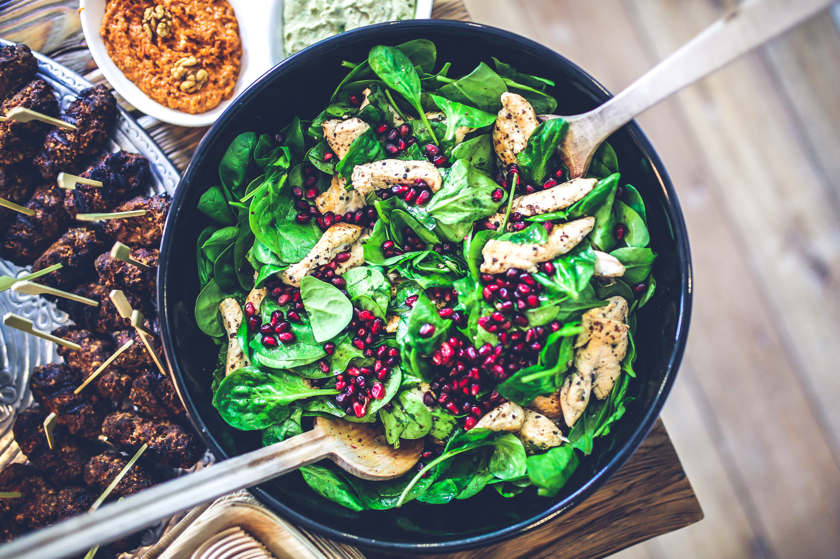
Technology Used:
TEAM AND PARTNERS
N. Narendra
N. Yamini Deepthi
S. Vasu deva Rao
Ch. Kavya
V. Likitha
M. Lavanya
B. Sowmya
Html
Css
Java script

Slide 11
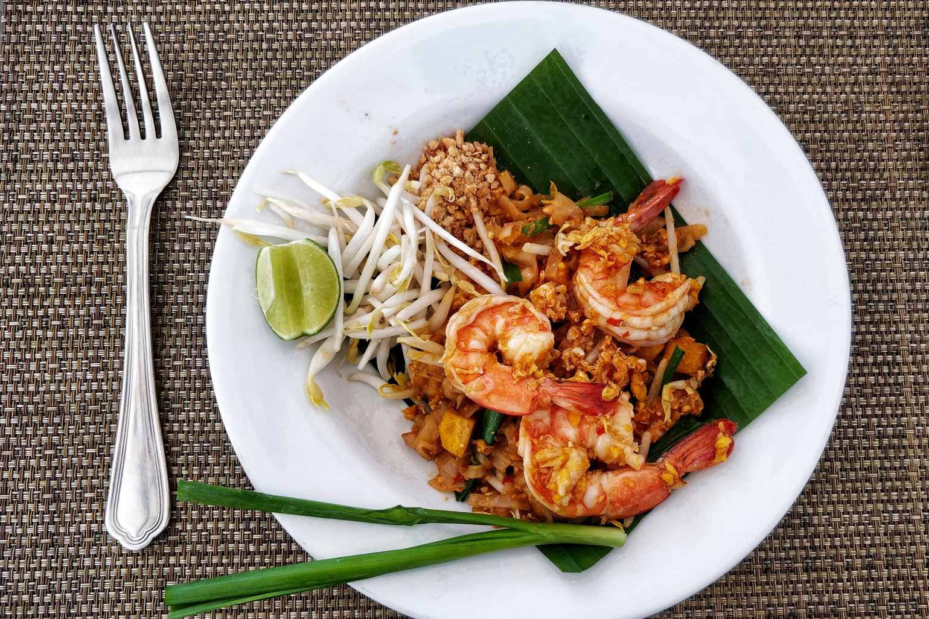
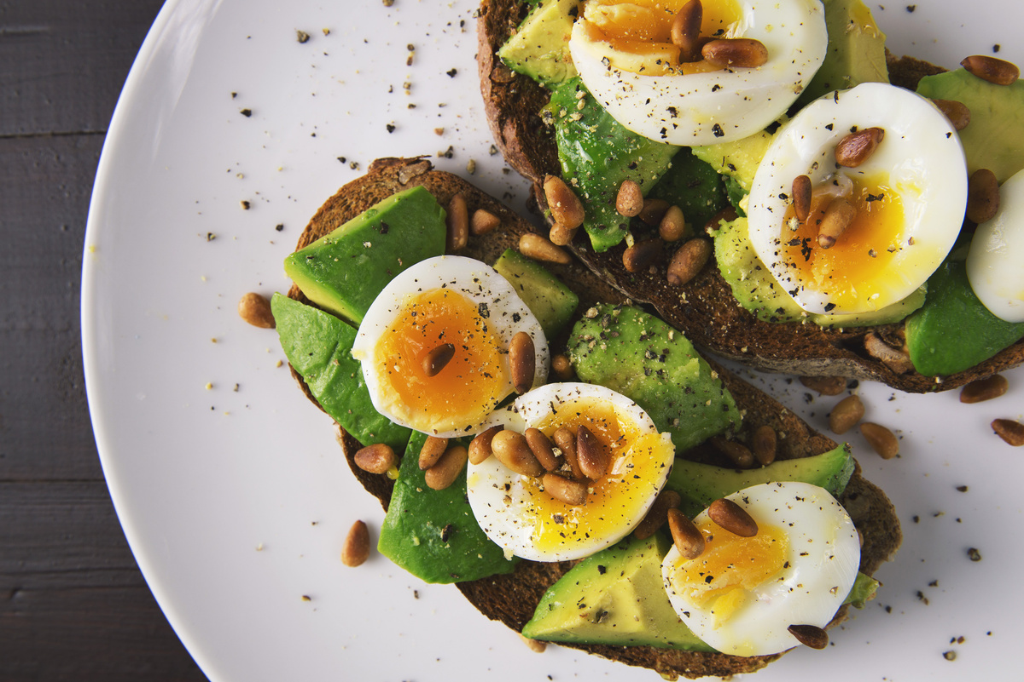
FUTURE VISION
Expansion to more cities and regions.
Introduction of new features (e.g., dietary filters, group orders).
Long-term goals and vision for the platform.

Slide 12

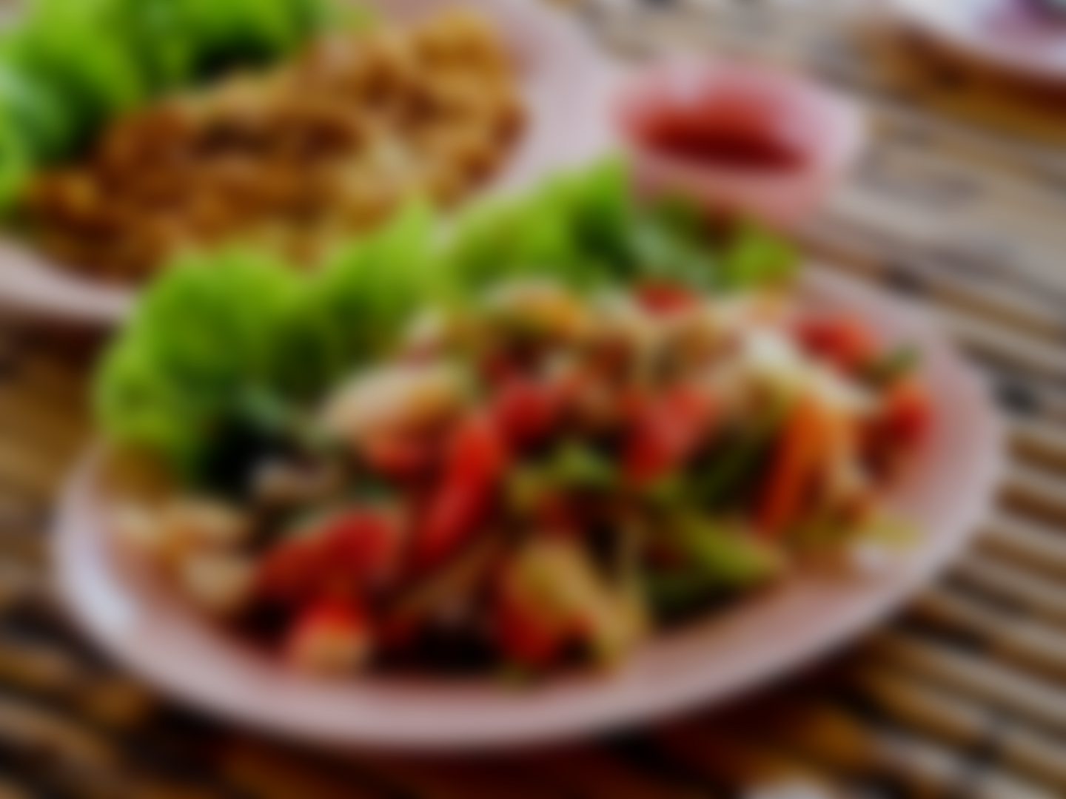
THANKS YOU
HEALTHY FOOD

